Slide 1
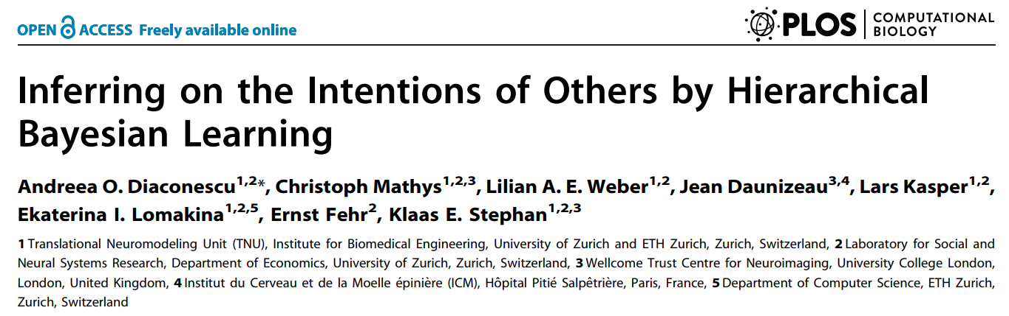

Slide 2
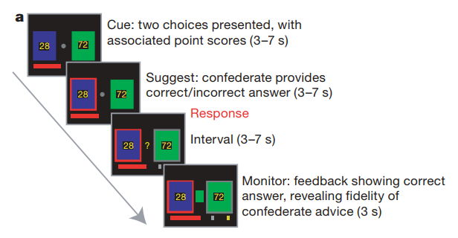
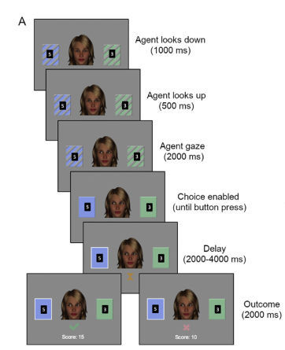
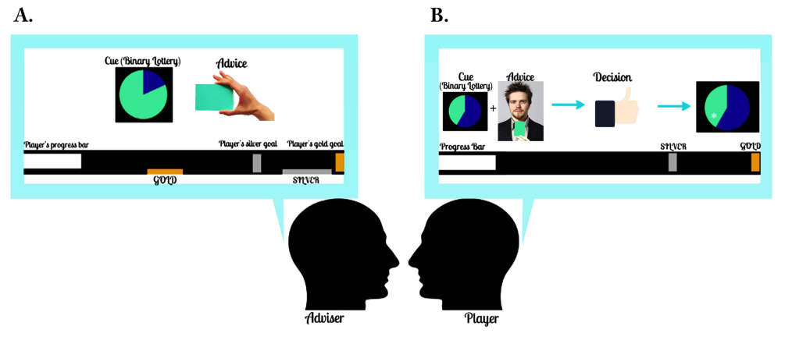
Behren(2008) BRL
Diaconescu (2014) HGF
Henco (2014) HGF
Notes:
贝叶斯模型做social learning

Slide 3
outline
Question? Represent other’s intention with unknown goals
Bayesian model: Lack of individual variability
Hierarchical learning (volatility) in social domain?
Social advice or non-social information?
Method?
HGF
Deception-free economic game
Result?
Hierarchical
Use volatility estimation
Integration

Slide 4
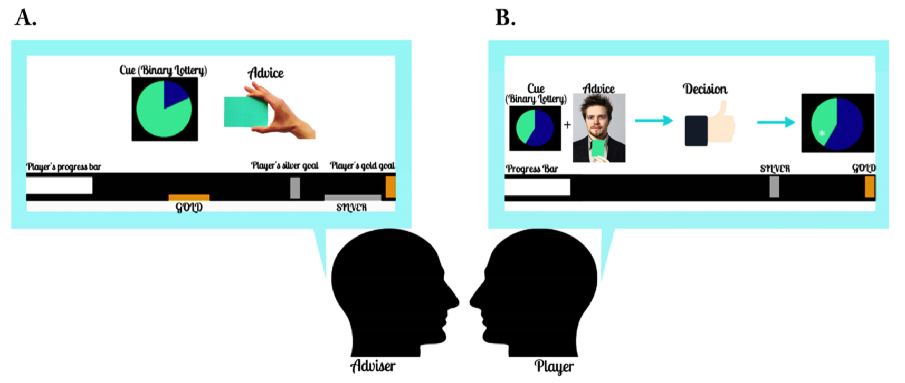
Experimental procedure
Adviser
a constant accuracy of 80%
Player
6 cue types (75:25, 65:35, 55:45, 45:55, 35:65, and 25:75)
Payment
Varying intention
Explicit readout
Control task

Slide 5
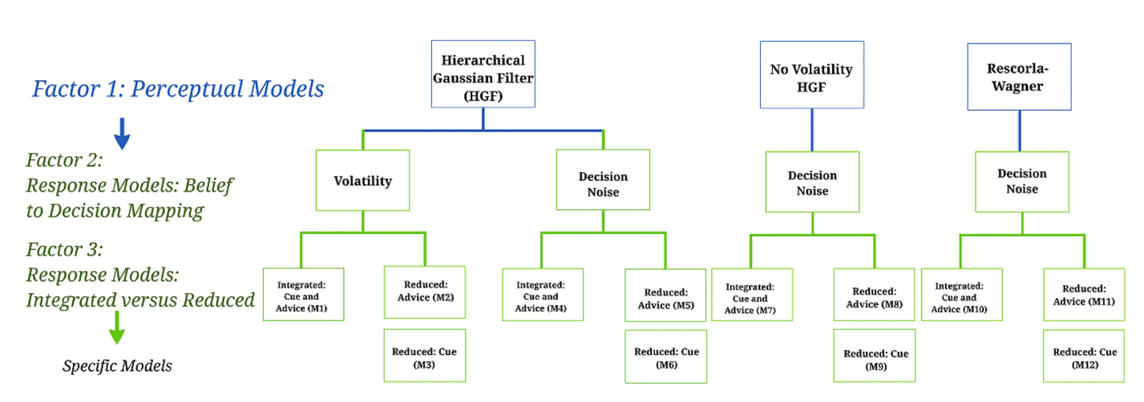
Modeling

Slide 6
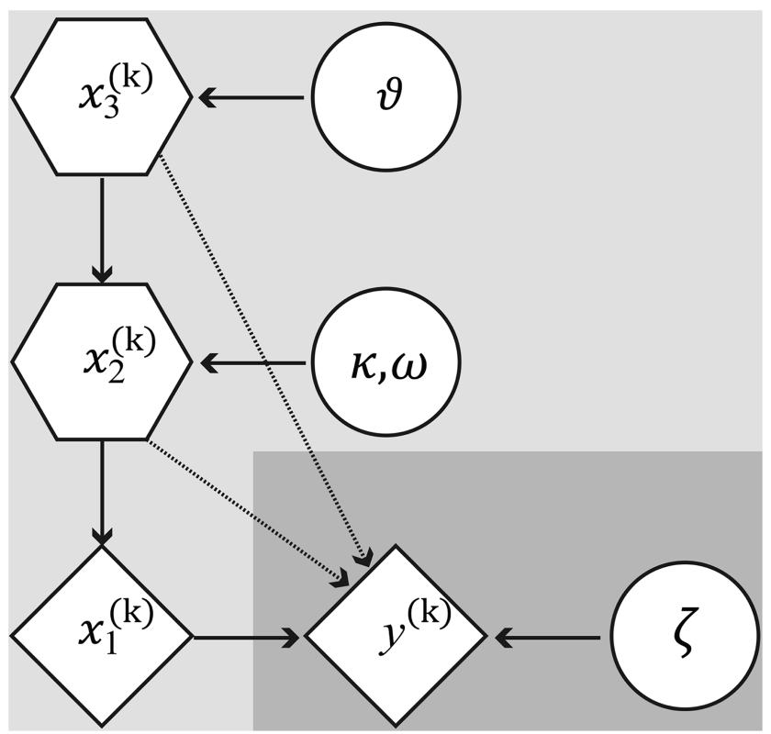



Modeling
HGF: Hierarchical Gaussian Filter

Slide 7
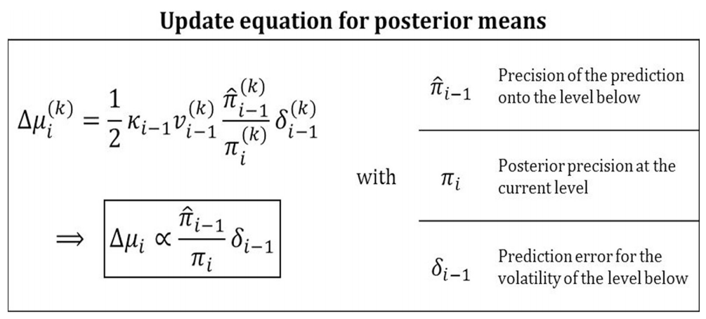
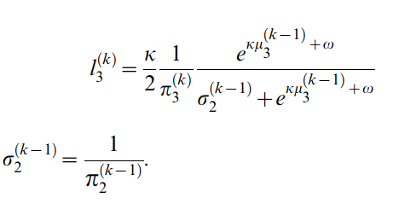
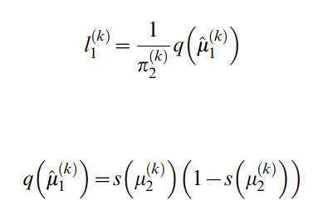
Modeling
HGF: Hierarchical Gaussian Filter
Variational Bayes
2-level
3-level

Slide 8

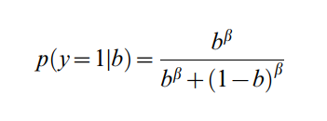
Modeling
Response model
Integration
Mapping

Slide 9
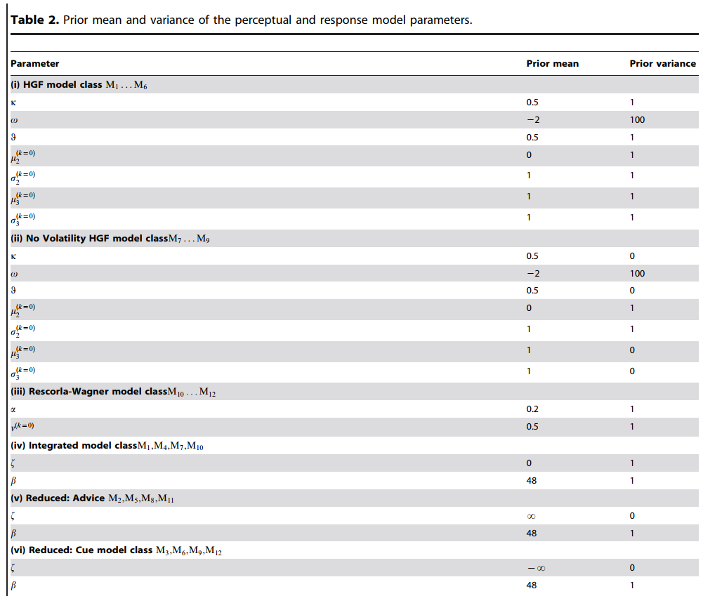



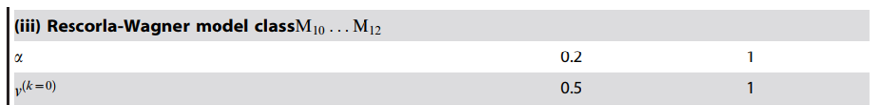
Modeling
Perceptual model

Slide 10
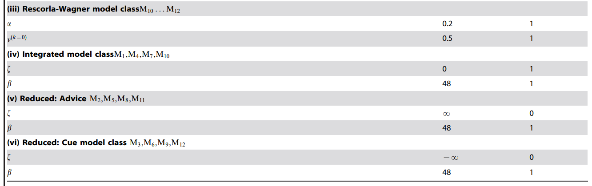


Modeling
Response model

Slide 11
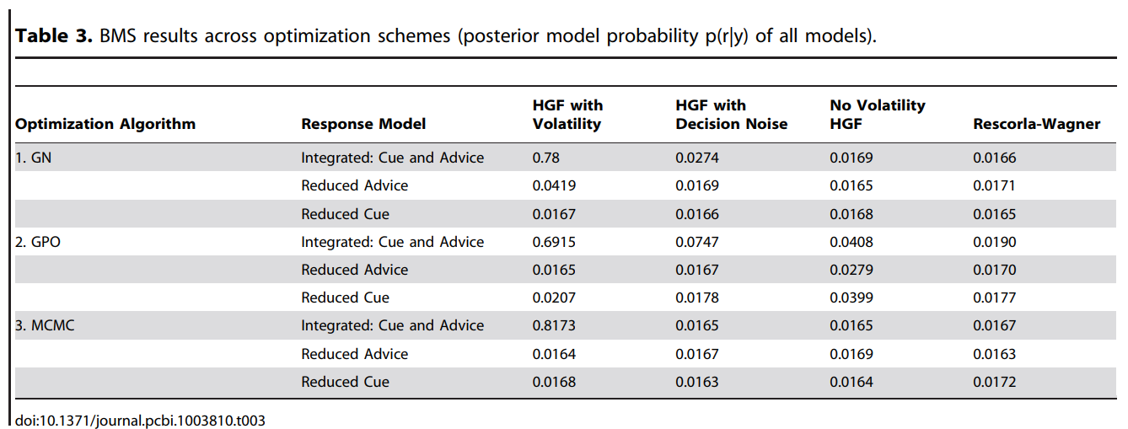
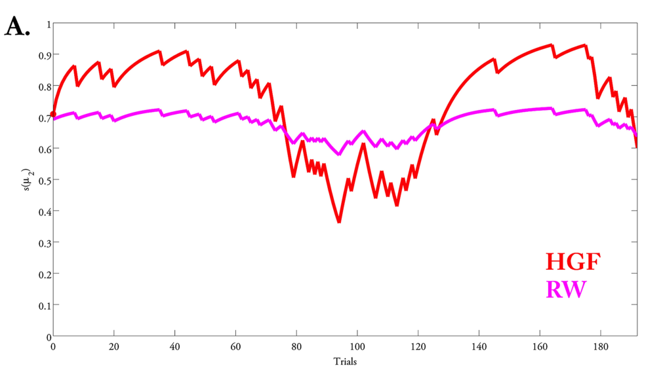
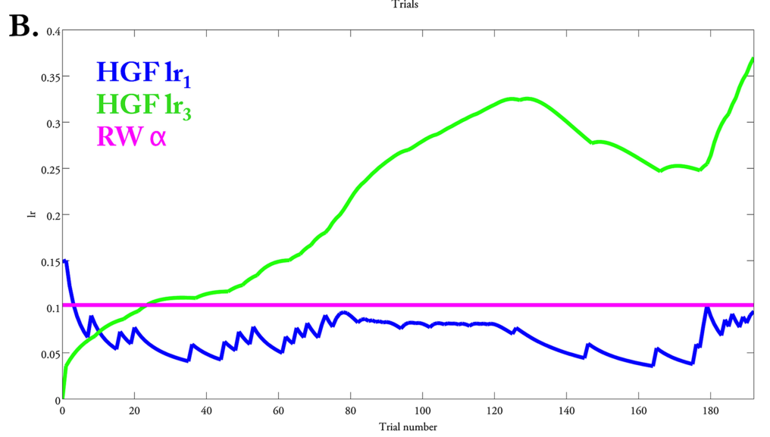
Q1-Q3

Slide 12
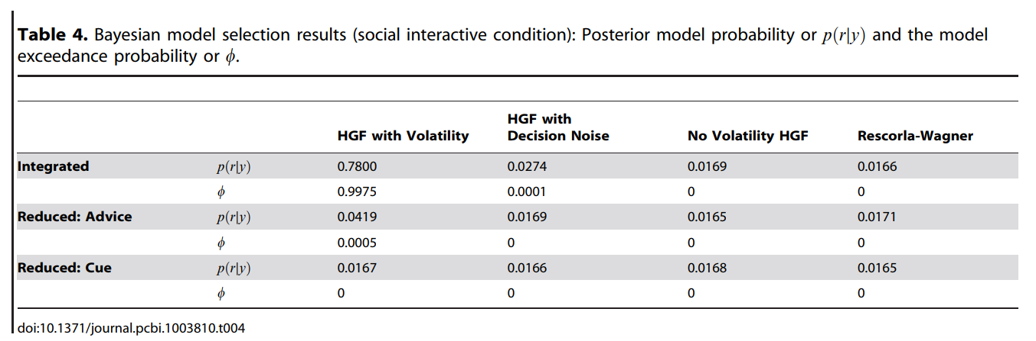
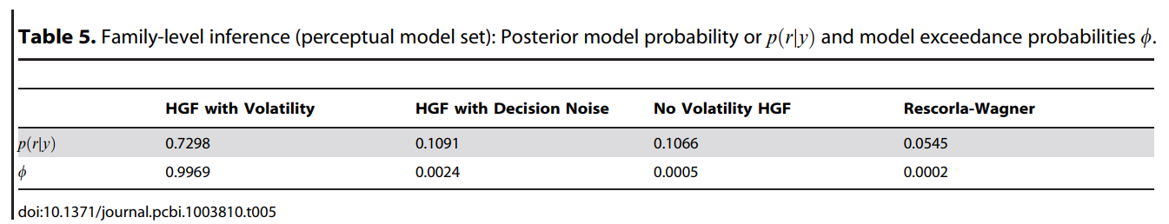
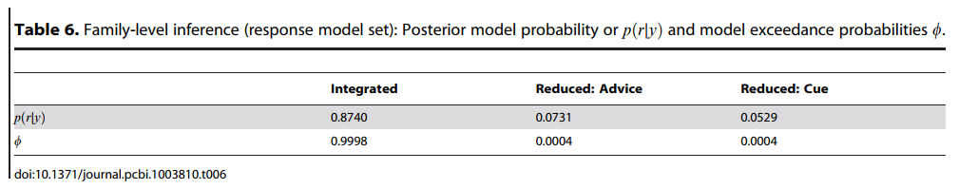
Q1-Q3

Slide 13
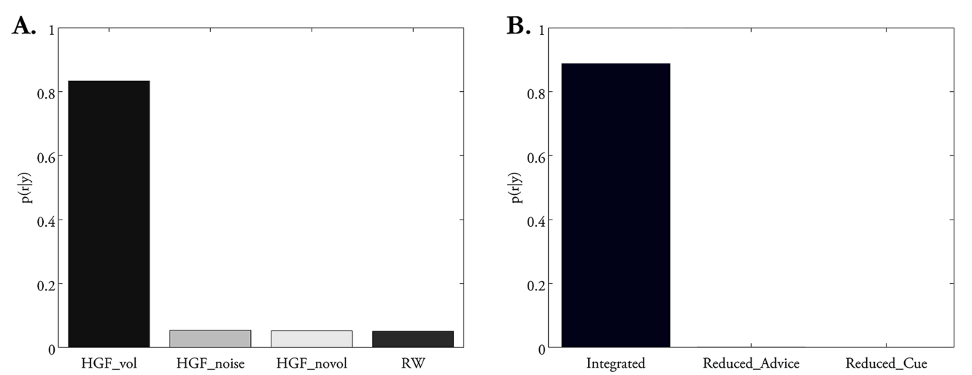
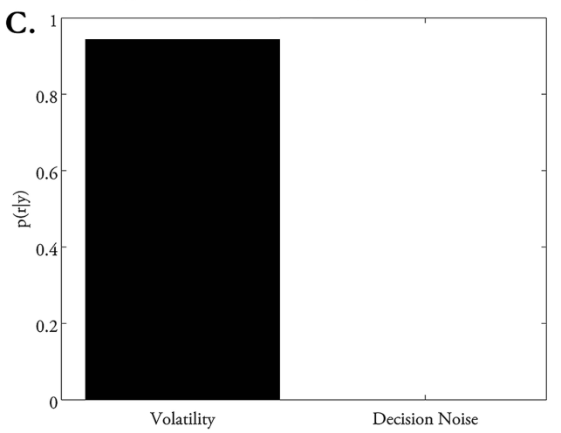
Q1-Q3

Slide 14
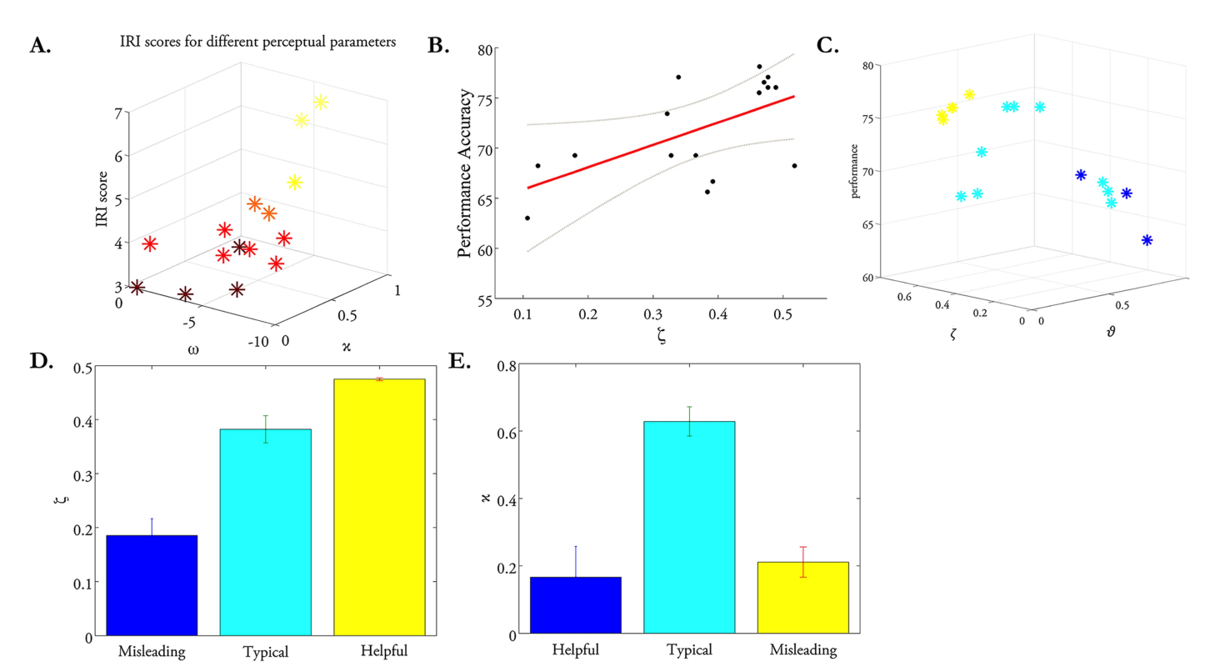
Q4-Q5

Slide 15
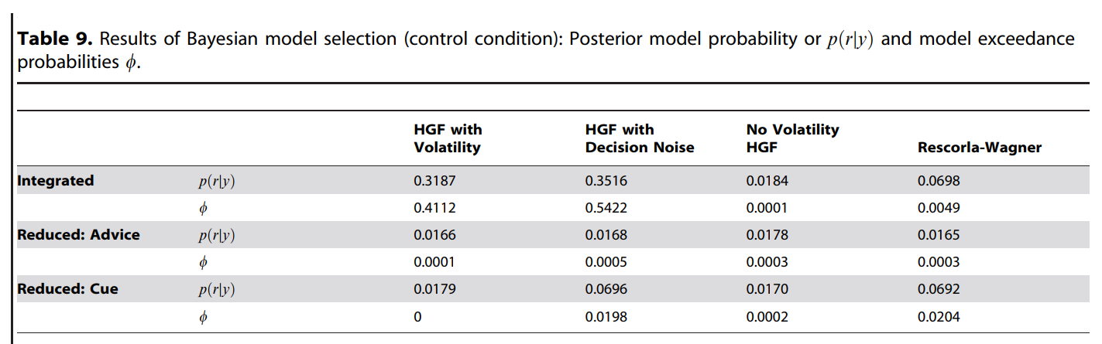
Q6

Slide 16
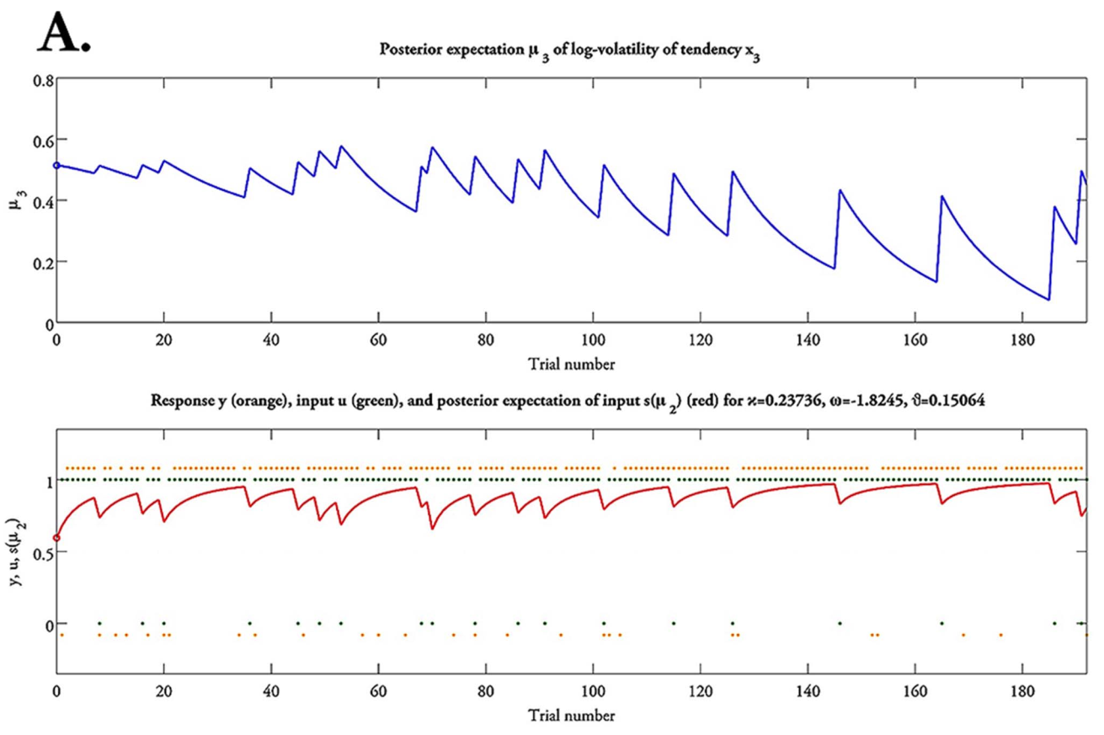
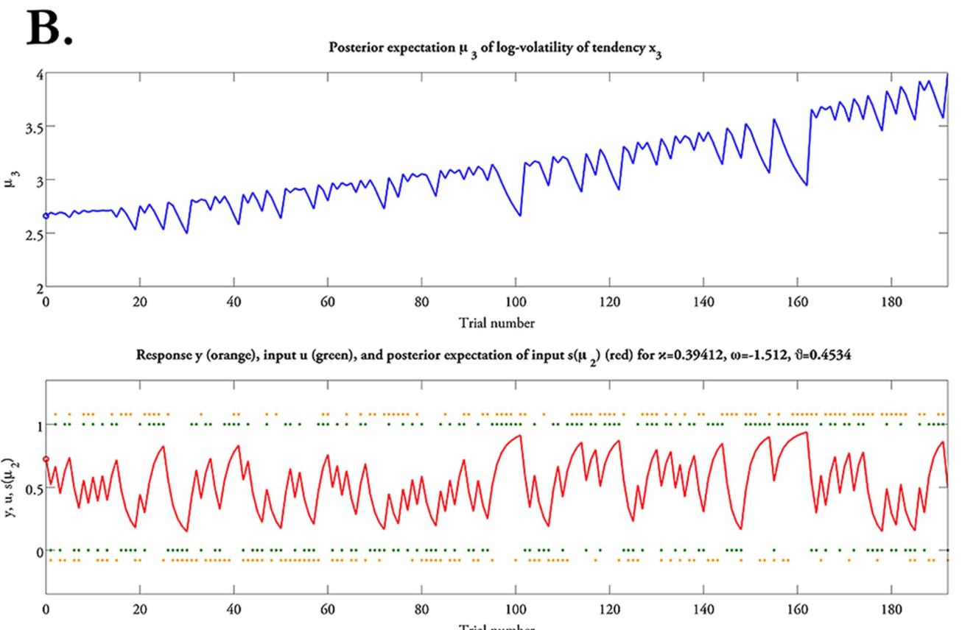
Q7
Helpful advisor
Misleading advisor

Slide 17
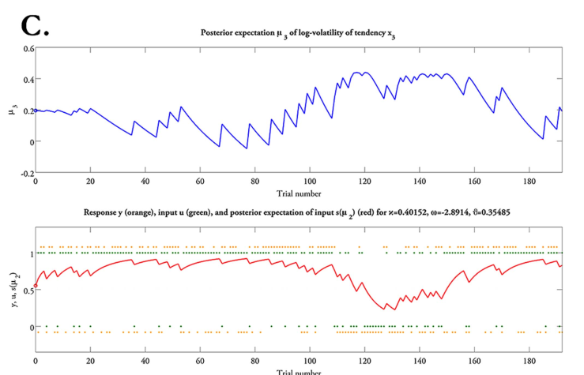
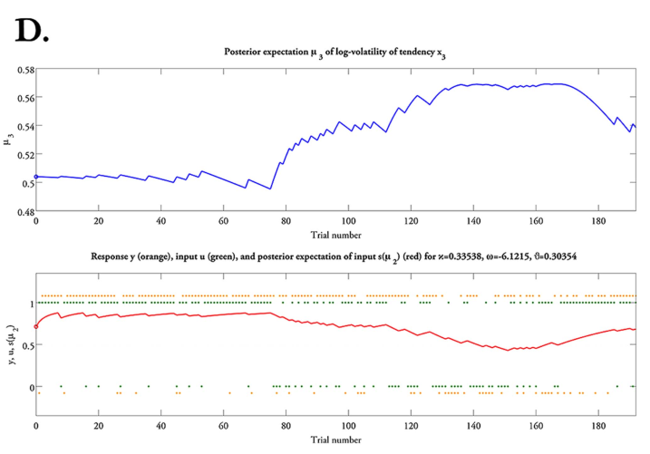
Q7
Typical advisor
Larger ω

Slide 18
Conclusion
Hierarchical
Use volatility estimation
Integration

